Slide 1

Voting System
Submitted by:
Verbeina Thapa
Ishan Kafle
Ubika Bajracharya
Submitted To :
Suman Devekota

Slide 2
INTRODUCTION:
The voting System is a comprehensive & intuitive platfrom meticulously crafted to revolutionize election management for ogranizations, institution, and govering bodies as desktop-based application developed using Java and JavaFX, with MySQL as the backend database. It is designed to automate and manage the core activities of a voting & pooling, reducing the need for manual work and minimizing human errors.
An voting technique. In this system, authorized voters can give his\her vote without using traditional paper based voting, polling method. A database is maintained in which all the names of voters with complete information are stored. Unlike traditional paper-based that require paper ,stamp, ink stuff this system introduce modern voting system.

Slide 3
Problem Statement
Long report processing time
Fear of loosing vote data (both capture)
Complex user experience

Slide 4
OBJECTIVES:
Here are the following objectives of this program:
Simple to use user interface
Data stored using database
Little to no data processing time

Slide 5
Functional Requirements:
This section explains what our voting system needs to do and how it should work. We’ve split it into the main features (functional requirements) and the qualities we want the app to have (non-functional requirements). There’s also a table at the end to show which parts are most important.
1. Login System:
Admin login with credentials verification from the database.
2. Candidate Management:
Add, update, and delete Candidate records.
3. Election Management:
Add, update, and delete election.
4. Database Connectivity:
Use MySQL for database management and continuity.
Ensure smooth data retrieval and storage using JDBC for database interactions.

Slide 6
✅ Non-Functional Requirements (NFR)
These define quality attributes and constraints.
1. Performance
The system should process transactions (sales, updates) within 2 seconds. Should support concurrent access by multiple users (if networked).
2. Scalability
Should handle increasing records and voting without performance degradation.
3. Usability
User-friendly interface with minimal training required.
4. Reliability
System should operate continuously with minimal downtime.
5. Security
Encrypted password storage.

Slide 7
Background
Lack of Transparency Many existing voting systems, especially electronic ones, do not provide verifiable proof to voters that their vote was accurately recorded and counted, leading to mistrust in the process.
Slow and Error-Prone Counting Process Manual vote counting or outdated systems can delay results and are more prone to human error, causing disputes that may affect the results.
High Cost of Operation
Existing system are very high in cost.

Slide 8
INCREEMENTAL DEVELOPMENT MODEL
The Incremental Development Model is a software development approach where the system is built and delivered in small, manageable parts (increments) rather than all at once. Hence we used incremental methodology.

Slide 9
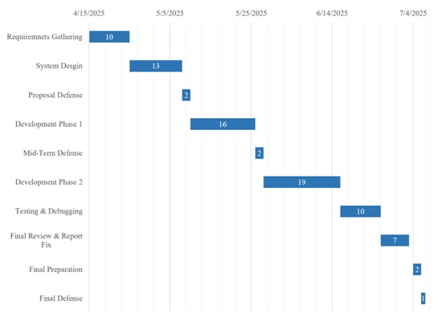
GANTT CHART

Slide 10
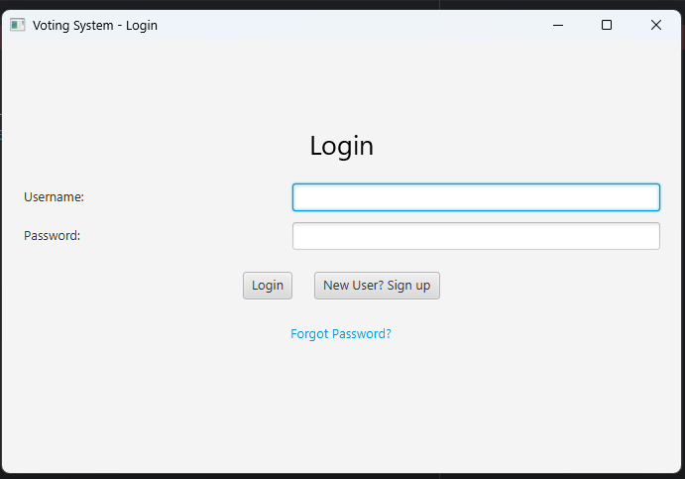
Interface Overview
Main interface(login UI)
Summary : login and signup screen allowing access based on user role
Components Used:
TextField (Username)
PasswordField
Button (Login, Sign Up)
VBox layout
Label (Title)

Slide 11
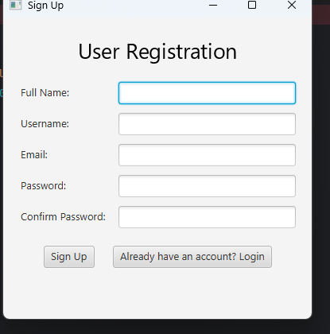
Interface Overview
Signup Interface
Summary: Registers new users with username, email, password, and role selection.
Components Used:
TextField (Username,fullname Email)
PasswordField
ComboBox (Role: Admin, Trainer, Member)
Button (signup, already…)
Label (Sign Up Title)

Slide 12
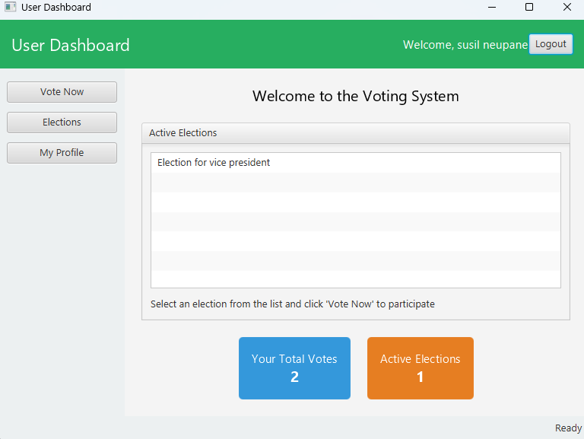
Interface Overview
Signup Interface
Summary: user dashboard
Components Used:
BorderPane layout
Label (Welcome message)
Button (vote now, election, my profile, logout)
TableView (ongoing election)
Input fields (vote )

Slide 13
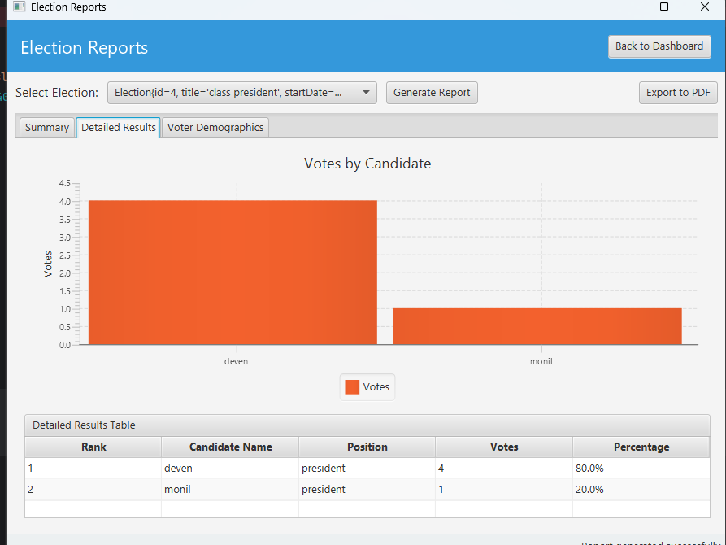
Interface Overview
Signup Interface(admin interface)
Summary: Election report
Components used :
Boarder panel view.
Buttons : generate report, export pdf

Slide 14
DELIVERABLES
A java based voting system that fulfill the objectives of making voting easier.
User manual will be provided to explain how to install, setup, and use the voting system.
A complete report on the project that includes system operation.

Slide 15
Conclusion
The Java-based Voting System project successfully addresses many of the common challenges associated with traditional and manual voting methods. By leveraging core Java technologies along with a user-friendly interface, the system enables secure, efficient, and transparent election processes. The application allows for effective voter authentication, reliable vote casting, and real-time result calculation, significantly reducing the chances of errors, fraud, and administrative burden.

